Slide 1
Oracle PL/SQL
PL/SQL Exceptions
LEVEL – LEARNER

Slide 2








Icon Used
Hands on Exercise
Reference
Questions
Points To Ponder
Coding Standards
Lend A Hand
Summary
Test Your Understanding

Slide 3

Overview
PL/SQL Exception session provides knowledge and understanding of the use of PL/SQL Exception handling in Oracle 10G and finally apply the syntax learned as part of this session in a case study provided.

Slide 4
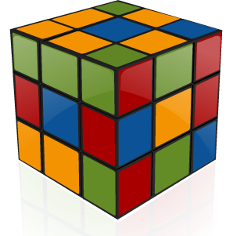
Objective
To understand the Pl/SQL Exceptions that a developer needs to know to work with it.
Exceptions
Implicit and User Defined Exceptions

Slide 5
Scenario
For complete understanding of ANSI SQL we are going to make use of Product Management System (PMS) for ABC Traders.
ABC Traders is a company which buys collectable model cars, trains, trucks, buses, trains and ships directly from manufacturers and sells them to distributors across the globe. In order to manage the stocking, supply and payment transactions the above software is developed.
As per the requirement of the trading company a inventory system is developed to collect the information of products and customers and their payment processing.

Slide 6
Database tables
There are many entities involved in Product Management System. PMS as given below which we will be dealing with throughout this course
Offices
To maintain information of Offices e.g. Office code, address, city etc.
Customer
To maintain customer details e.g. Customer Name, address
Employees
To maintain employee
details e.g. id,
Name etc.
Products
To maintain information of products e.g. product id, name etc.
Payments
To maintain information of payments done e.g. payment date, amount etc.
Orders
To maintain Orders done by customers e.g. order no ,date etc.
OrderDetails
To maintain Orders done by customers e.g. order no ,date etc.

Slide 7
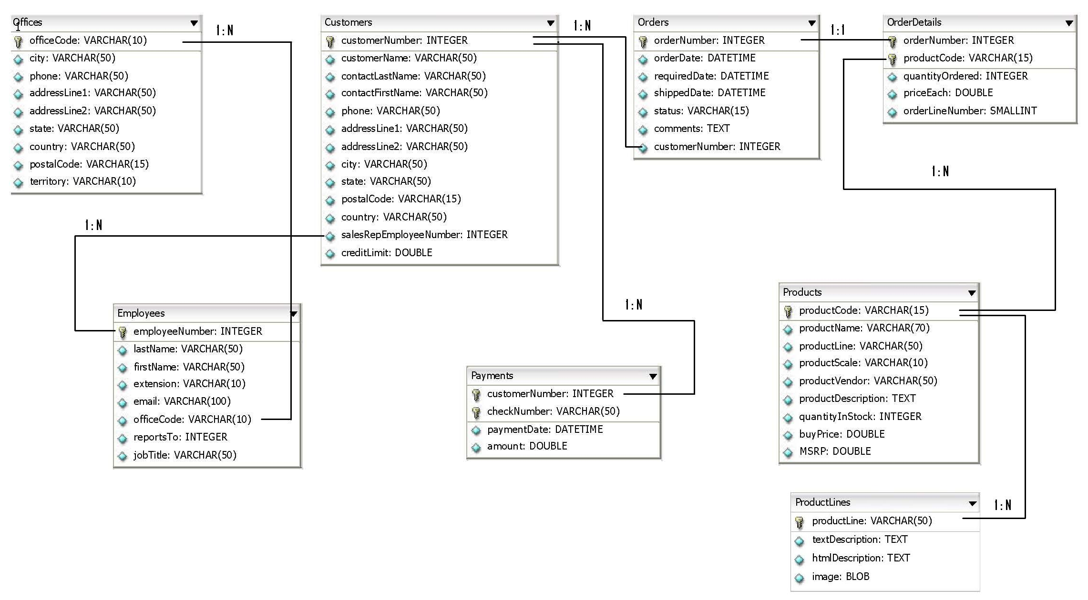
Schema diagram
Notes:
Trainer Note:
You can use a computer to type documents, send email, and browse the internet.
You can also use it to handle spreadsheets, accounting, database management, presentations, games, and more.
Software
Set of instructions for the hardware to accomplish a task.
List down any ten hardware parts of computer.
List down any five storage devices.
List down any five input devices.
What is the device which converts picture on a paper to an electronic image in computer ?

Slide 8

Scenario
Hi!
If I give invalid employee number its throwing some unknown error please fix this for me.
Lets learn about PL/SQL exception which will help us meet TIM’s requirements..

Slide 9
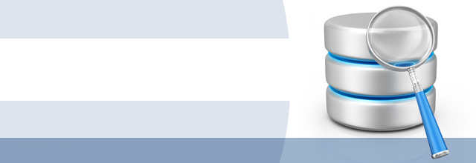
Do you Know
What are PL SQL Exceptions
?

Slide 10
Exception
What is an Exception?
A warning or error condition is called an exception.
Examples of exceptions in Oracle:
Divide by Zero.
Sub query returns more than one row when it is expected to return only one row.
Data type mismatch exceptions.
What happens when exception occurs?
When an exception occurs in Oracle, the PL/SQL block terminates with failure and exception is propagated to the calling environment.
How can Exception be handled?
Exceptions can be handled using exception handlers where user can specify what needs to be done when an exception occurs.

Slide 11
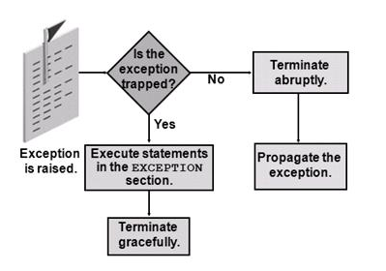
What happens when exception occurs?
Oracle checks if the exception is handled/trapped
Exception is raised by the PL/SQL program
If no handlers present the program terminates and the error is propagated to the calling environment.
If Exception handlers are present, then the statements in Exception block is executed

Slide 12
What happens when an error occurs?
When an error occurs in the PLSQL block , an exception is raised.
This causes a termination of the PLSQL block execution by Oracle.
Control then is transferred to the exception section of the PLSQL block(if one exists).
The exception section consists of handlers for handling the exceptions.
The control never returns to that block after you finish handling the exception.
Instead control is passed to the enclosing block (if any).

Slide 13
Advantages of Exception Handling
Exception Handling improve readability by letting you isolate error-handling routines.
The primary algorithm is not obscured by error recovery algorithms.
Exception handling improve reliability by handling the exceptions properly.
Just add an exception handler to your PL/SQL block. If the exception is ever raised in that block (or any sub-block), you can be sure it will be handled.

Slide 14
Exception Types
Exception
Pre-Defined Exception
User-Defined Exception
These exceptions are already defined in Oracle
Example:ZERO_DIVIDE
These exceptions are created by developers.

Slide 15
Predefined Exception
They are raised implicitly at runtime by database engine when any error occurs.
Every predefined exception is associated with an Error code and Error name.
We need to handle these exceptions by referring their names.
These exceptions are defined in the STANDARD package.
Standard package is a default package in PL/SQL .
This package contains types, exceptions, subprograms which are available automatically to PL/SQL programs.
Example: Oracle raises the predefined exception “NO_DATA_FOUND”
if a SELECT INTO statement returns no rows.

Slide 16
Few Pre-Defined Exception
EXCEPTION | ORACLE ERROR | RAISED WHEN
INVALID_NUMBER | ORA-01722 | String contains a character and you try to convert it into a number.
TOO_MANY_ROWS | ORA-01422 | A SELECT INTO statement returns more than one row.
ZERO_DIVIDE | ORA-01476 | The program attempts to divide a number by zero.

Slide 17
Exception Handlers
What are exception handlers?
To handle raised exceptions, you write separate block called exception handlers.
Syntax:
DECLARE
Declaration section
BEGIN
Execution section
EXCEPTION
WHEN exception_name1 THEN
Error handling statements
WHEN exception_name2 THEN
Error handling statements
WHEN Others THEN
Error handling statements
END;
There can be multiple handlers in a PL/SQL program to handle different types of exceptions
Handler One
Exception Handler
Handler Two
Optional/Default handler

Slide 18
How PL/SQL Exception Propagate?
BEGIN
IF X=1 THEN
RAISE A;
ELSIF X=2 THEN
RAISE B;
ELSE
RAISE C;
EXCEPTION
WHEN A THEN
……….
END;
Assume that the condition X=1 is met then exception A will be raised.
The control is transferred to the exception block where A is handled.
Note: Exceptions A,B,C are user defined exceptions.

Slide 19
Learn Predefined Exception with a Example
This example demonstrates how exception will be handled if no data is found:
Scenario: Assume that we have a table called emp_details with columns empno, ename, salary. We develop a SQL to select the employee name based on the employee id and employee salary. Assume get_emp_name is the procedure with parameters salary and employee number used for selecting the name of the employee.
If no record is found for the given employee number then oracle raises NO_DATA_FOUND exception which is a pre-defined exception.
Let us see how this exception is handled inside a stored procedure.

Slide 20
Predefined Exception Example
CREATE OR REPLACE PROCEDURE get_emp_name(v_empno NUMBER,v_sal NUMBER)
AS
BEGIN
SELECT ename FROM emp_details WHERE salary=v_sal AND empno=v_empno;
EXCEPTION
WHEN NO_DATA_FOUND THEN
DBMS_OUTPUT.PUT_LINE(“No such employee exists”);
END;
When no record matches the given employee number, then this exception is raised and handled here

Slide 21
User Defined Exception
PL/SQL allows developers to define exceptions of their own. These exceptions are used by programmers to handle abnormal scenarios in application by raising and handling them.
Steps to create user defined exception:
STEP 1: Declare the exception.
STEP 2: Raise the exception.
STEP 3: Handle the exception.

Slide 22
Step 1:Declaring User Defined Exception
User defined exception must be declared using EXCEPTION keyword.
Syntax :
<exception_name> EXCEPTION;
Example:
INVALID_NAME EXCEPTION;

Slide 23
Step 2:Raising User Defined Exception
Exceptions can be raised in PLSQL block using RAISE keyword.
Syntax:
RAISE <exception_name>;
Example:
RAISE INVALID_NAME ;

Slide 24
Step 3:Handling User Defined Exception
Handle this exception using exception handler as shown below,
Syntax:
WHEN <exception_name> THEN
Example:
WHEN INVALID_NAME THEN
<Exception handling logic
Example: Print an error in the console.>

Slide 25
Learn User Defined Exception with an example
Scenario: Assume that we have a table called loan_details with columns loan_id, loan_amount, interest_rate to store loan information offered by ABC bank.
Business Rules:
The bank does not gives loans for amount less than 1 lakh.
If user applies for a loan amount less than 100000 the system should not allow the process to happen.
How can a developer implement this?
Developer creates a user defined exception to handle the scenario. He raises a exception whenever loan amount is less than 100000.

Slide 26
User Defined Exception-Example
Create a procedure to raise an exception when a customer orders an item which has price less than 20000.
CREATE OR REPLACE PROCEDURE insert_record (v_order_no IN NUMBER, v_price IN NUMBER)
IS
min_price EXCEPTION;
BEGIN
IF v_price <20000 THEN
RAISE min_price;
ELSE
INSERT INTO order_details VALUES(v_order_no, v_price);
END IF;
EXCEPTION
WHEN min_price
THEN
DBMS_OUTPUT.PUT_LINE(‘Price of all product is more than 20000’);
END;
Exception declared
Exception raised if loan amount < 100000
Exception handled by printing the error message in the console.

Slide 27
Lend A Hand
Now we are well versed with commands lets test our understanding using short case study
Case Study Scenario:
This case study is to develop a Course Management System (CMS) for ABC University. The following are the two use cases for which the database needs to be designed.
Add Course
– To add the course details into the course management system.
Retrieve Course
– Retrieve the courses stored in the system and display it.
The courses to be added will have the following attributes Course Code, Course Name, Number of participants, Course Description, Course Duration, Course start date and Course Type.
Course Management System (CMS) ABC University

Slide 28
Lend a Hand-User Defined Exception
Pre-Requisite: We will use course_fees table in CMS.
Problem Statement : When loading course fees a validation need to be performed that the discount on the fee should not exceed 10% of the base fees of that course.
If discounts are given for the course which is beyond 10% of the base fees then application should display a message and abort the process.
Solution: We will create a user-defined exception by name excess_discount to handle it.
STEP 1:
excess_discount EXCEPTION;
STEP 2:
RAISE excess_discount;
STEP 3:
WHEN excess_discount.THEN
DBMS_OUTPUT.PUT_LINE(“Discount should not be greater than 10% of base fees.”);
Declaring the exception.
Raising the exception.
Exception Handler
Let us see how to use this user defined exception in a stored procedure.

Slide 29
Lend a Hand-User Defined Exception
Create a stored procedure update_discount to update the discount given for a course.
Parameters are course_code and discount amount.
Before updating the course_fees table, validate if the discount amount is less than 10% of base fees.
If it is greater then raise the exception excess_discount exception.
Handle the exception by displaying a error message in the console.

Slide 30
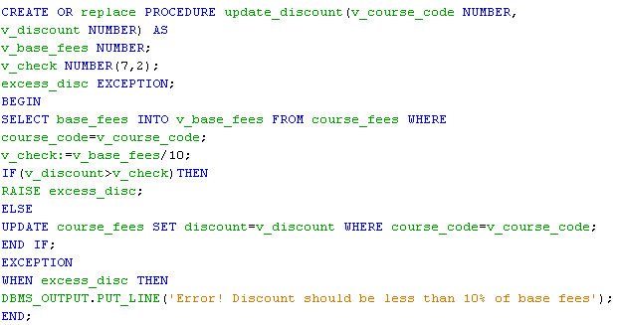
Lend a Hand-User Defined Exception
Checking if current discount greater than 10% of base fees.

Slide 31
RAISE_APPLICATION_ERROR
This is a built in procedure used for raising user-defined ORA- error messages from stored procedures/ functions.
This built-in procedure is used for raising exceptions under abnormal conditions (or) any business rule failure to the client side which can be caught and handled accordingly.
Example: Oracle raises an error with a specific error code and returns the error code to the application. Based on the error code obtained, the application can determine the problem encountered in the SQL procedure
Error number should be of the range between –20000 and –20999.
Error messages should be less than 512 characters.

Slide 32
RAISE_APPLICATION_ERROR
Syntax:
RAISE_APPLICATION_ERROR (error_number NUMBER, error_msg VARCHAR2);
This procedure can be used by SQL procedures/functions to raise exceptions.
When invoked it stops the program execution and returns a user-defined (or) oracle error code and message to the application.
The exception raised can be handled like any other oracle predefined exception.

Slide 33
RAISE_APPLICATION_ERROR-Example
In this example a stored procedure is used raise an error whenever we try to update a product which does not exist.
CREATE OR REPLACE PROCEDURE sp_addproduct( v_product_code varchar2, v_product_name varchar2) AS
BEGIN
UPDATE product_dim SET product_name=v_product_name
WHERE product_key=v_product_code;
IF SQL%NOTFOUND THEN
RAISE_APPLICATION_ERROR(-20202,'This is not a valid product');
END IF;
END sp_addproduct;

Slide 34
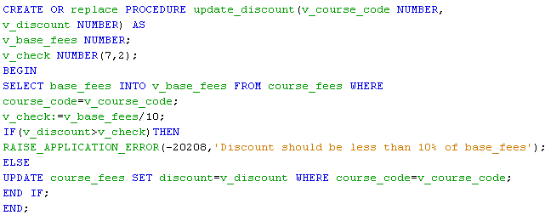
Lend a Hand-RAISE_APPLICATION_ERROR
Let us modify the stored procedure which we created while learning user defined exception to raise application error.

Slide 35
Check Your Understanding
Advantages of exception.
What are user defined exception?
Can I handle multiple exception in the same exception block?
What is the keyword used to explicitly throw an exception?

Slide 36

Summary
We have learnt following
Exceptions
Implicit and User Defined Exceptions

Slide 37
Source
http://en.wikipedia.org/wiki/SQL
Disclaimer: Parts of the content of this course is based on the materials available from the Web sites and books listed above. The materials that can be accessed from linked sites are not maintained by Cognizant Academy and we are not responsible for the contents thereof. All trademarks, service marks, and trade names in this course are the marks of the respective owner(s).

Slide 38
Oracle PL/SQL
You have successfully completed -
PL/SQL Exceptions

Slide 39
Change Log
Version Number | Changes made
V1.0 | Initial Version
V1.1 | Slide No. | Changed By | Effective Date | Changes Effected

